Slide 1
COMP 122/L Lecture 1
Mahdi Ebrahimi Slides adapted from Dr. Kyle Dewey

Slide 2
Motivation

Slide 3
public static void main(String[] args) {
...
}
Notes:
-I just want to write my code

Slide 4


public static void main(String[] args) {
...
}
Notes:
-Image source: http://media.firebox.com/pic/p5294_column_grid_12.jpg
-Have some magic happen

Slide 5
public static void main(String[] args) {
...
}
3.14956
Notes:
-Image source: http://media.firebox.com/pic/p5294_column_grid_12.jpg
-And then get a result

Slide 6
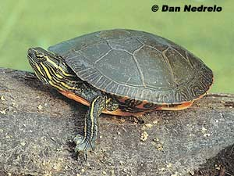
public static void main(String[] args) {
...
}
3.14956
Notes:
-Image source: http://dnr.wi.gov/eek/critter/reptile/images/turtleMidlandPainted.jpg
-But what if your magic isn’t working fast enough?

Slide 7




public static void main(String[] args) {
...
}
More Efficient Algorithms
3.14956
Notes:
-Image source: http://dnr.wi.gov/eek/critter/reptile/images/turtleMidlandPainted.jpg
-Let’s apply some better algorithms, improve time complexity, and so on...

Slide 8

public static void main(String[] args) {
...
}
More Efficient Algorithms
3.14956
Notes:
-Image source: http://turtlefeed.tumblr.com/post/35444735335/ive-lost-track-of-how- many-turtle-on-skateboard
-...and we’re left with a slightly faster turtle

Slide 9
Why are things still slow?

Slide 10
The magic box isn’t so magic

Slide 11
Array Access
arr[x]
Constant time! (O(1))
Where the random in random access memory comes from!

Slide 12

Array Access
arr[x]
Constant ti
me! (O(1))
random in ran mes from!
Where the
dom access
memory co
Notes:
-Image source: http://blog.fractureme.com/wp-content/uploads/2014/12/dwight-schrute- false-288x300.jpg

Slide 13
Array Access
Memory is loaded as chunks into caches
Cache access is much faster (e.g., 10x)
Iterating through an array is fast
Jumping around any which way is slow
Can make code exponentially faster
Notes:
-Matrix multiply is the example at the end.
If you take the graduate-level parallel programming course, you’ll watch a matrix multiply program seemingly nonsensically get around 5-6X faster by using a memory layout which looks asinine, but processors love

Slide 14
Instruction Ordering
int x = a + b; int y = c * d; int z = e - f;
int z = e - f; int y = c * d; int x = a + b;
Notes:
-Two code snippets that appear to do the exact same thing
-Both should take the same amount of time, right?

Slide 15
Instruction Ordering
int x = a + b; int y = c * d; int z = e - f;
int z = e - f; int y = c * d; int x = a + b;
3 Milliseconds?
3 Milliseconds?
Notes:
-Two code snippets that appear to do the exact same thing
-Both should take the same amount of time, right?

Slide 16

Instruction Ordering
int x = a + b; int y = c * d; int z = e
int z = e - f; int y = c * d; x = a + b;
- f; int
ds? 3
3 Millisecon
Milliseconds?
Notes:
-Image source: http://www.dreamstime.com/stock-photo-nope-word-typed-scrap-torn- paper-pinned-to-cork-notice-board-word-well-known-meme-modern-slang- image43914016

Slide 17
Instruction Ordering
Modern processors are pipelined, and can execute sub-portions of instructions in parallel
Depends on when instructions are encountered
Some can execute whole instructions in different orders
If your processor is from Intel, it is insane.

Slide 18
The Point
If you really want performance, you need to know how the magic works
“But it scales!” - empirically, probably not
Chrome is fast for a reason
If you want to write a naive compiler, you need to know some low-level details
If you want to write a fast compiler, you need to know tons of low-level details
Notes:
-A bunch of Chrome is written using low-level machine instructions (assembly)
-Ruby on Rails is horrendously slow, and is built on the idea of scaling up.
A startup I know of beat a 50 node Rails cluster using one machine.
Even in more typical settings, typically it’s something like 10 Rails nodes to one optimized node.
Twitter used to run Rails, but found that it was too slow to handle the sort of scale that it handles now.

Slide 19
So Why Circuits?
Notes:
-Image source: http://media.firebox.com/pic/p5294_column_grid_12.jpg
-It’s to turn this

Slide 20
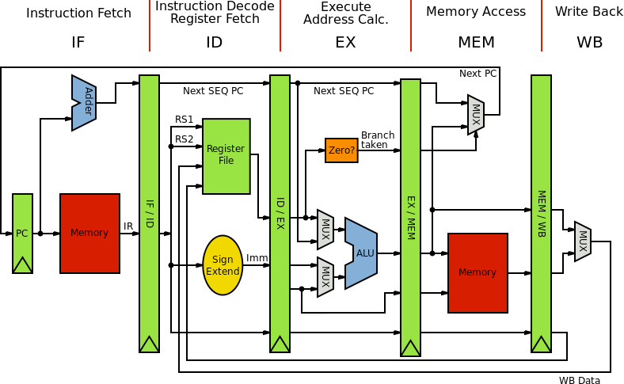
So Why Circuits?
Notes:
-Image source: https://en.wikipedia.org/wiki/MIPS_instruction_set#/media/
File:MIPS_Architecture_%28Pipelined%29.svg
-...into this
MIPS (Microprocessor without Interlocked Pipelined Stages) is a reduced instruction set computer (RISC) instruction set architecture (ISA)[

Slide 21
So Why Circuits?
Basically, circuits are the programming language of hardware
Yes, everything goes back to physics

Slide 22
Working with Different Bases

Slide 23
What’s In a Number?
Question: why exactly does 123 have the value 123? As in, what does it mean?
Notes:
-Not a philosophy question
-This is actually kind of brain-melting, but once this is understood everything else becomes second-nature

Slide 24
What’s In a Number?
123
Notes:
-Start with 123

Slide 25
What’s In a Number?
1
2
3
Notes:
-Break it down into its separate digits

Slide 26
What’s In a Number?
1
2
3
Hundreds
T ens
Ones
Notes:
-Values of each digit

Slide 27
What’s In a Number?
1 | 2 |  |  | 3
Hundreds 100 | 10 | Tens | 10 | 1 | Ones 1 | 1
Notes:
-Values of each digit

Slide 28
Question
Why did we go to tens? Hundreds?
1 | 2 |  |  | 3
Hundreds 100 | 10 | Tens | 10 | 1 | Ones 1 | 1

Slide 29
Answer
Because we are in decimal (base 10)
1 | 2 |  |  | 3
Hundreds 100 | 10 | Tens | 10 | 1 | Ones 1 | 1

Slide 30
Another View
123

Slide 31
Another View
1
2
3
Notes:
-Break it down into its separate digits

Slide 32
Another View
1
2
3
1 x 10²
2 x 10¹
3 x 10⁰
Notes:
-Values of each digit

Slide 33
Conversion from Some Base to Decimal
Involves repeated division by the value of the base
From right to left: list the remainders
Continue until 0 is reached
Final value is result of reading remainders from bottom to top
For example: what is 231 decimal to decimal?

Slide 34
Conversion from Some Base to Decimal
231

Slide 35
Conversion from Some Base to Decimal
Remainder
10 231
23
1
Notes:
123 / 10 = 23 + 1
123: dividend
10: divisor
23: quotient (koshent)
1: remainder

Slide 36
Conversion from Some Base to Decimal
Remainder
10 231
10 23
1
3
2

Slide 37
Conversion from Some Base to Decimal
Remainder
10 231
10 23
1
3
2
10 2
0
Notes:
-Final value: 231 (reading remainders from bottom to top)

Slide 38
Now for Binary
Binary is base 2
Useful because circuits are either on or off, representable as two states, 0 and 1

Slide 39
Now for Binary
1010

Slide 40
Now for Binary
1
0
1
0

Slide 41
Now for Binary
1
0
1
0
Eights
Fours
Twos
Ones

Slide 42
Now for Binary
1 Eights | 0 Fours | 1 Twos | 0 Ones
1 x 2³ | 0 x 2² | 1 x 2¹ | 0 x 2⁰
8 | 0 | 2 | 0

Slide 43
Question
What is binary 0101 as a decimal number?

Slide 44
Answer
What is binary 0101 as a decimal number?
5
0 Eights | 1 Fours | 0 Twos | 1 Ones
0 x 2³ | 1 x 2² | 0 x 2¹ | 1 x 2⁰
0 | 4 | 0 | 1

Slide 45
From Decimal to Binary
What is decimal 57 to binary?

Slide 46
From Decimal to Binary
57

Slide 47
From Decimal to Binary
Remainder
2 57
28
1

Slide 48
From Decimal to Binary
Remainder
2 57
2 28
1
0
14

Slide 49
From Decimal to Binary
Remainder
2 57
2 28
1
0
0
2 14
7

Slide 50
From Decimal to Binary
Remainder
2 57
2 28
1
0
0
1
2 14
2 7
3

Slide 51
From Decimal to Binary
Remainder
2 57
2 28
1
0
0
1
1
2 14
2 7
2 3
1

Slide 52
From Decimal to Binary
Remainder
2 57
2 28
1
0
0
1
1
1
2 14
2 7
2 3
2 1
0

Slide 53
Hexadecimal
Base 16
Binary is horribly inconvenient to write out
Easier to convert between hexadecimal (which is more convenient) and binary
Each hexadecimal digit maps to four binary digits
Can just memorize a table

Slide 54
Hexadecimal
Digits 0-9, along with A(10), B (11), C (12),
D (13), E (14), F (15)

Slide 55
Hexadecimal Example
What is1AF hexadecimal in decimal?

Slide 56
Hexadecimal Example
1
A
F

Slide 57
Hexadecimal Example
1
A
F
Two-fifty-sixes
Sixteens
Ones

Slide 58
Hexadecimal Example
1
A
F
Two-fifty-sixes 1 x 16²
Sixteens 10 x 16¹
Ones 15 x 16⁰

Slide 59
Hexadecimal Example
1
A
F
Two-fifty-sixes 1 x 16²
Sixteens 10 x 16¹
16 16 16 16 16
16 16 16 16 16
(160)
Ones 15 x 16⁰
1 1 1 1 1
1 1 1 1 1
1 1 1 1 1
(15)
256

Slide 60
Hexadecimal to Binary
Previous techniques all work, using decimal as an intermediate
The faster way: memorize a table (which can be easily reconstructed)

Slide 61








Hexadecimal to Binary
Hexadecimal | Binary
0 | 0000
1 | 0001
2 | 0010
3 | 0011
4 | 0100
5 | 0101
6 | 0110
7 | 0111
Hexadecimal | Binary
8 | 1000
9 | 1001
A (10) | 1010
B (11) | 1011
C (12) | 1100
D (13) | 1101
E (14) | 1110
F (15) | 1111
Notes:
-0x1AF: 0001 1010 1111
-0101 1010: 0x5A

